Slide 1
Customizing Learning for All Students: Teaching in a Blended Learning Environment
ISTE 2015
Carrie Wozniak – Assistant Superintendent Fraser Public Schools

Slide 2
Good Morning!
Welcome and Introductions
Sharing the Fraser Story - District Strategic Plan
Competency Based Learning - Defined
Creating Blended Units of Instruction Systemically: Professional Development – Unit Design Framework
Sample Units and Building Blended Units within a Learning Management System
  Understanding the role of a Digital Curriculum Planner
  Sharing Fraser’s Platform itslearning
Wrap-up and Questions

Slide 3

Checking into the Toolbox
http://fraseriste.weebly.com/

Slide 4
The Fraser Story
http://www.fraser.k12.mi.us/pages/FraserPS/News/Watch_Frasers_New_Videos

Slide 6
Competency Based Learning
Refers to systems of instruction, assessment, grading, and academic reporting that are based on students demonstrating that they have learned the knowledge and skills they are expected to learn as they progress through their education.

Slide 7
Competency Based Learning
In public schools, competency-based systems use state learning standards to determine academic expectations and define “competency” and “proficiency” in a given course, subject area, or grade.
Competency with proficiency…

Slide 8
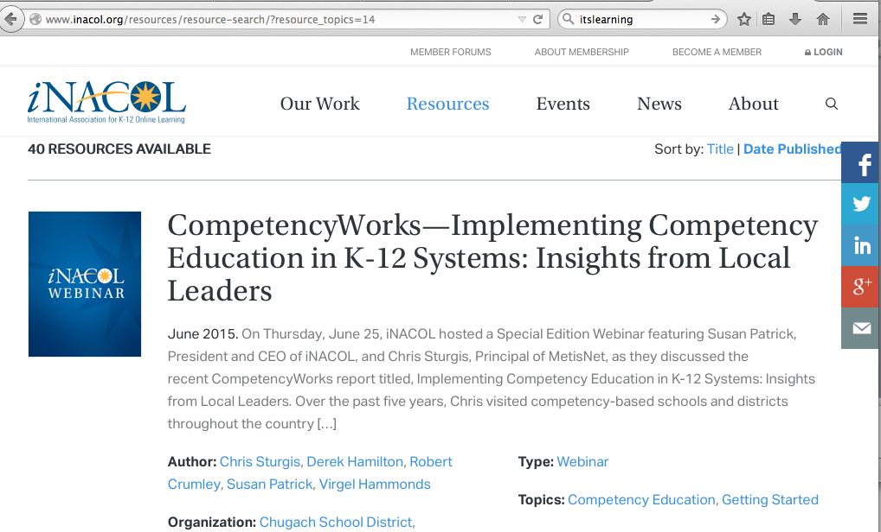
Research and Support

Slide 9
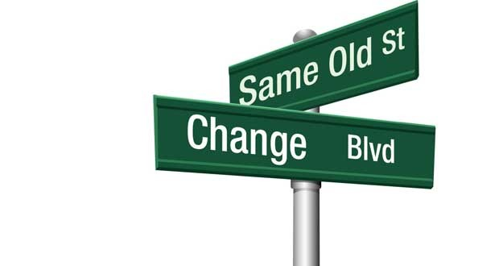
Competency Based Learning
Grounding the staff with a common understanding of CBL – using the Learning Management System.
  Teachers built a working definition of CBL.
  Teachers discussed Fixed Learning versus Competency Based Learning.
Building Grade Level Curriculum Teams to discuss CBL and Unit Design Work.
Example:
  4th Grade Interdisciplinary Unit - Model

Slide 10
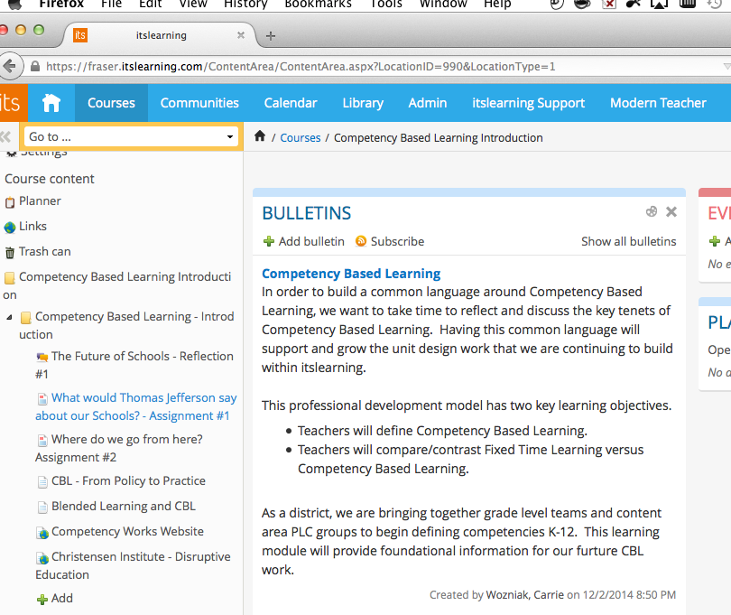
The LMS: itslearning
Modeling a new way of learning to staff

Slide 11
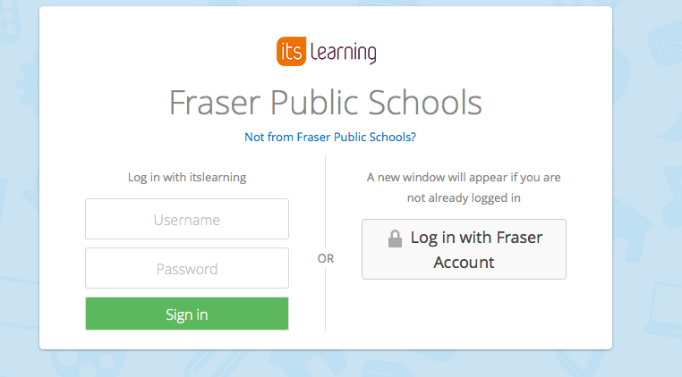
Exploration within itslearning
https://fraser.itslearning.com/Index.aspx
username: tempuser
password: Fraser2015

Slide 12
Fraser’s CBL Framework
For each discipline (Math, Science, ELA, Social Studies, Foreign Language, and Electives), identify the standards, skills, content, macro and micro concepts, and enduring understandings by grade band (district) and unit (grade).
  K-2
  3-5
  6-8
  9-12

Slide 13
Fraser’s CBL Framework (cont.)
Identify competency statements to describe 3-Dimensional Learning Competencies (one for each knowledge dimension)
Declarative Knowledge – Content Competency
Procedural Knowledge – Skill Competency Process, Skill, and Habits of Mind
Conceptual Knowledge – Concept Competency Relationships within and across disciplines (organized around unifying ideas that support deep learning of content)
Resource: Modern Teacher Flip Book

Slide 14
Fraser’s CBL Framework (cont.)
District Level – Overarching Goals (What do we want a Fraser Graduate to know and be able to do?)
Course/Grade Level (Units of Instruction)
  Content Competency
  Skills Competency
  Conceptual Competency
    (Students will …)
Lesson Level
  Learning Objectives (I can statements…) that are aligned to Standards and link back up the to Competencies.

Slide 15
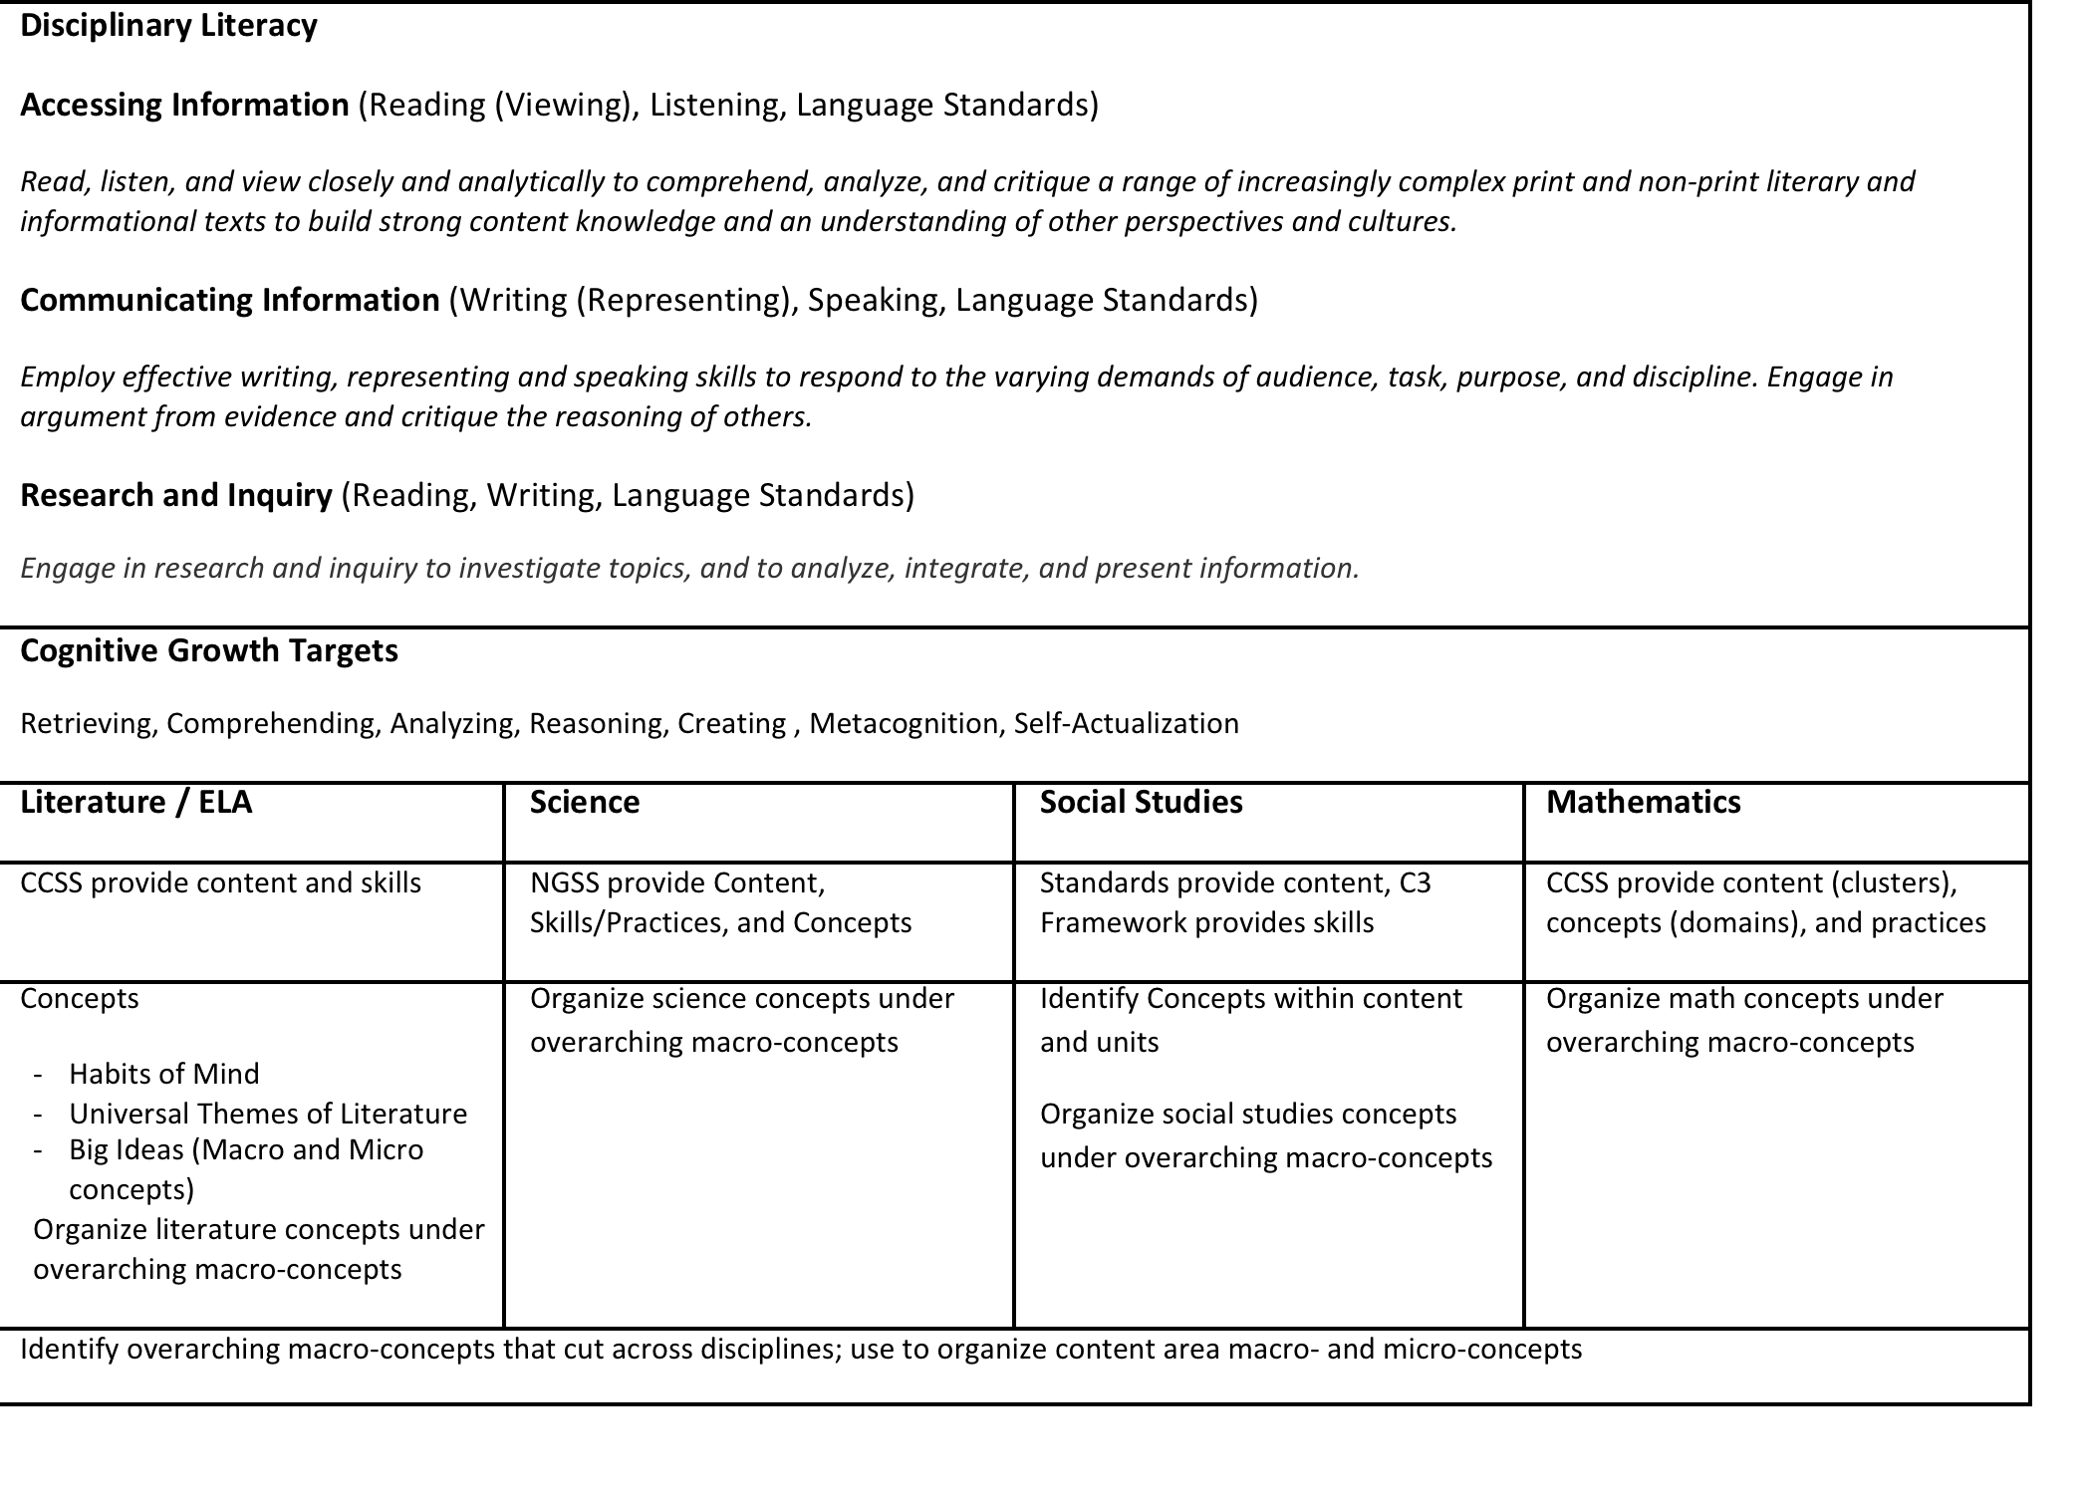
District Overview

Slide 16
What does this look like at the Classroom Level?

Slide 17
Concept
Competencies
Content Competencies
Skill Competencies

Slide 18
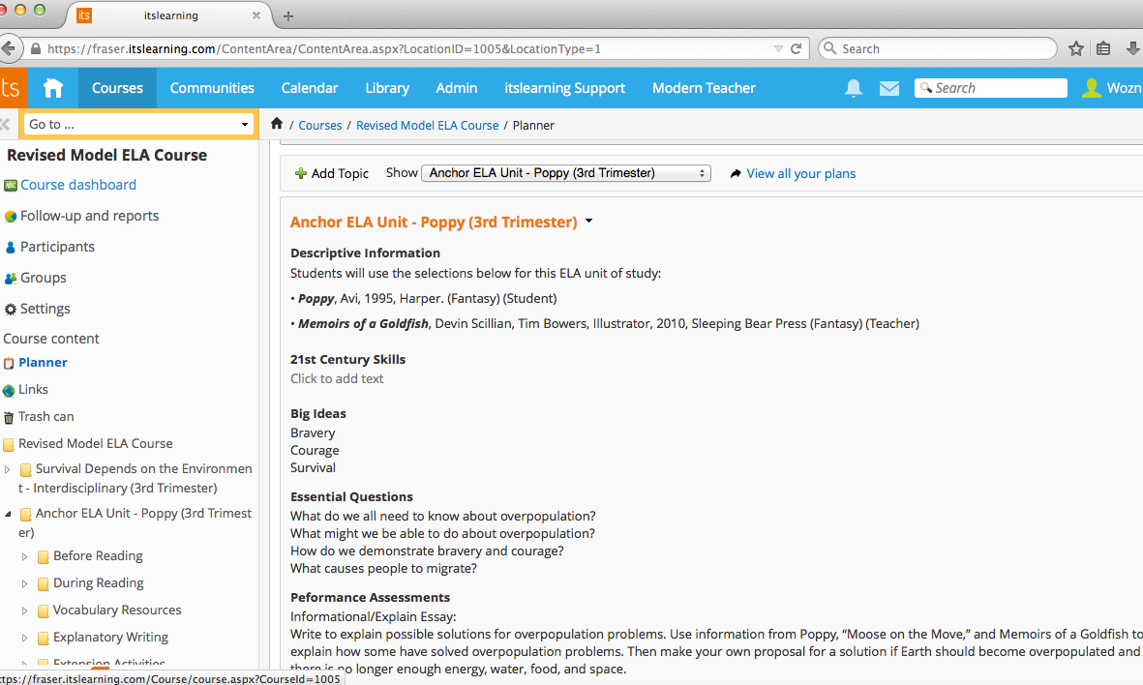
How does this look within the LMS – itslearning?
Purposeful Planning is Key

Slide 19
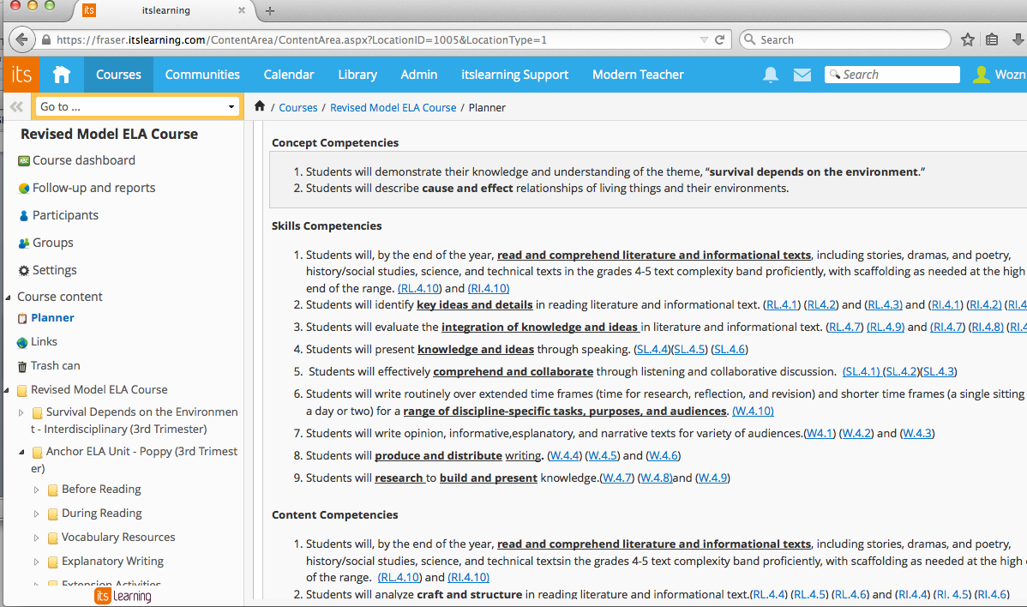
Competencies are linked to ELA CCSS Standards

Slide 20
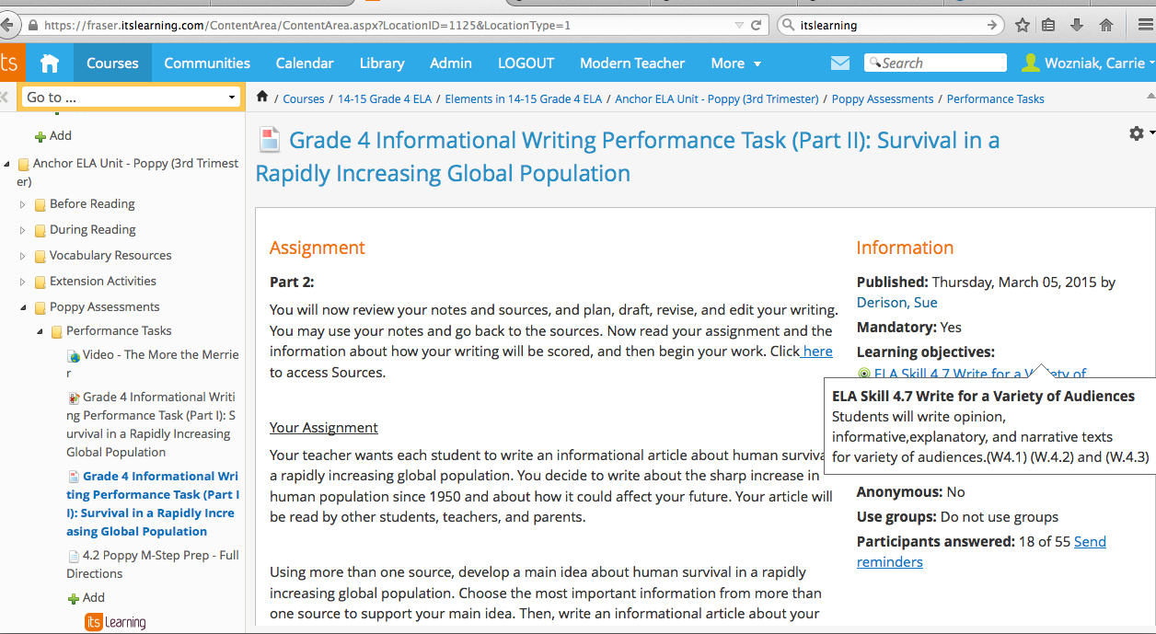
Performance Tasks are aligned to Competency Statements and Standards

Slide 21
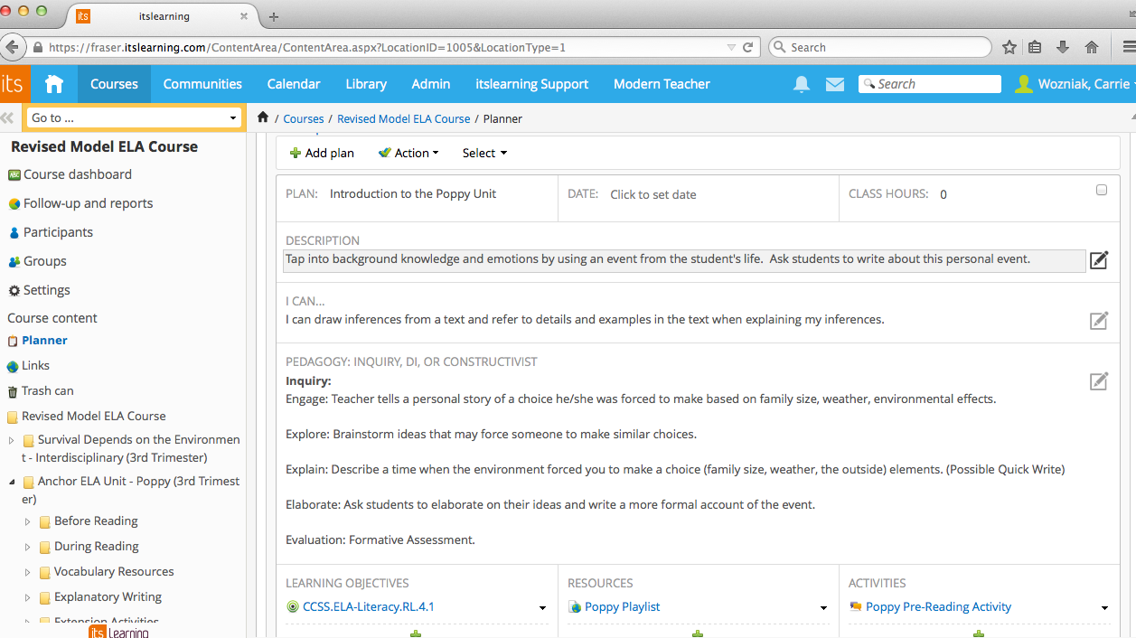
Pedagogy is built into the Learning Management System
Modern Teacher Framework

Slide 22
Additional Components for CBL
K -12 Writing Rubrics Aligned to the Common Core and the three modes of discourse (Persuasive/Argument, Inform/Explain, and Narrative).
K – 12 Close and Critical Reading Rubrics
K – 12 Grammar Continuum

Slide 23
Next Steps
We are using the three lenses of competencies for each grade level/course:
  Content Competency
  Skills Competency
  Conceptual Competency
  Each Department uses either the CCSS, NGSS, C3, and MDE Standards to develop K-12 District Competencies by the end of the 2014-2015 School Year.

Slide 24
Key Components
K-12 Competencies aligned to Assessments.
Each Grade Level/Course – Syllabus that identifies the Competencies.
Each Grade Level/Course – Units of Instruction aligned to K-12 Competencies and Standards (Students will…).
Lesson Plans – aligned to Standards (I can statements…).

Slide 25
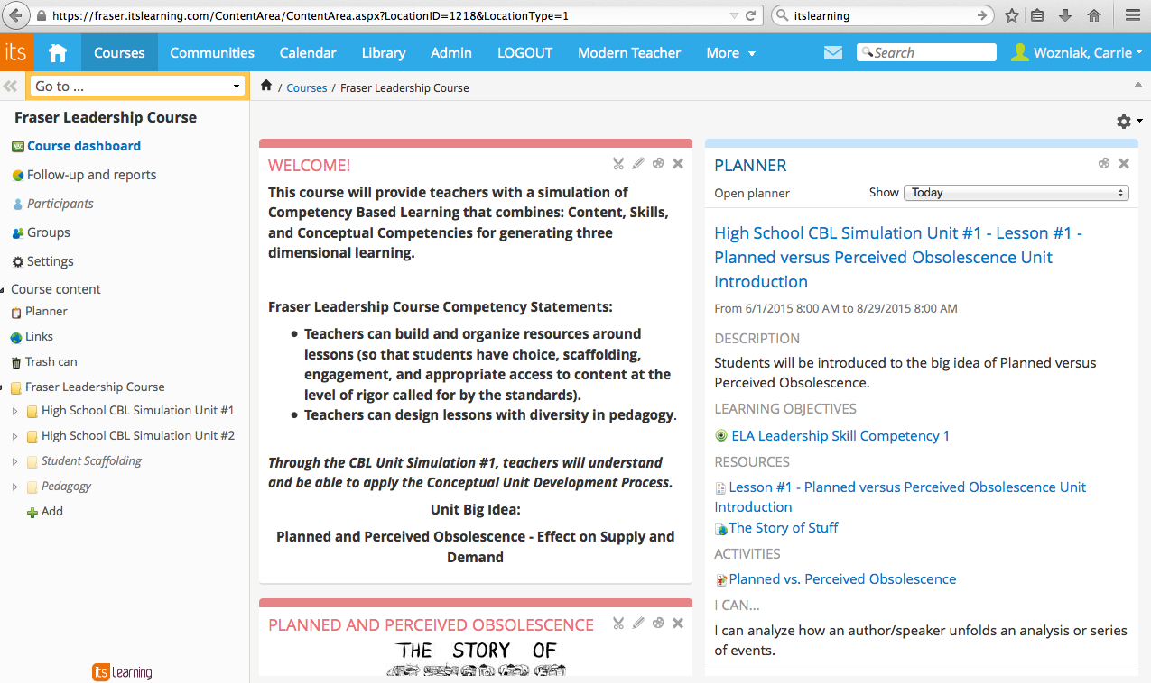
How do we continue to move forward? Growing Leadership.

Slide 26

Discussion and Questions

Slide 27


Questions/Comments

