Slide 1

Assessment Practices in Competency-Based Systems
Fraser Public Schools
February 16th, 2017
Ms. Carrie Wozniak, Fraser Public Schools
Dr. Michael Lonze, Fraser Public Schools
Notes:
Dave -Introduction

Slide 2
Goals
Learn about Fraser’s Competency Based Learning model using a systemic and strategic approach for school redesign.
This session will:
provide a framework for understanding Competency Based Learning and
explore how assessments are being designed to align to clearly defined learning bands and district competency statements.

Slide 3
a little bit about Fraser…

Slide 4
FRASER TODAY
[9] SCHOOLS IN THE DISTRICT
[5,261] STUDENTS
[1,803] SCHOOL OF CHOICE STUDENTS (34% OF POPULATION)
[39%] STUDENTS RECEIVING FREE/ REDUCED LUNCH
CAUCASIAN (78%) 
AFRICAN AMERICAN (12%) 
MULTI-RACIAL (5%) 
HISPANIC (3%) 
ASIAN (2%) 

Slide 5
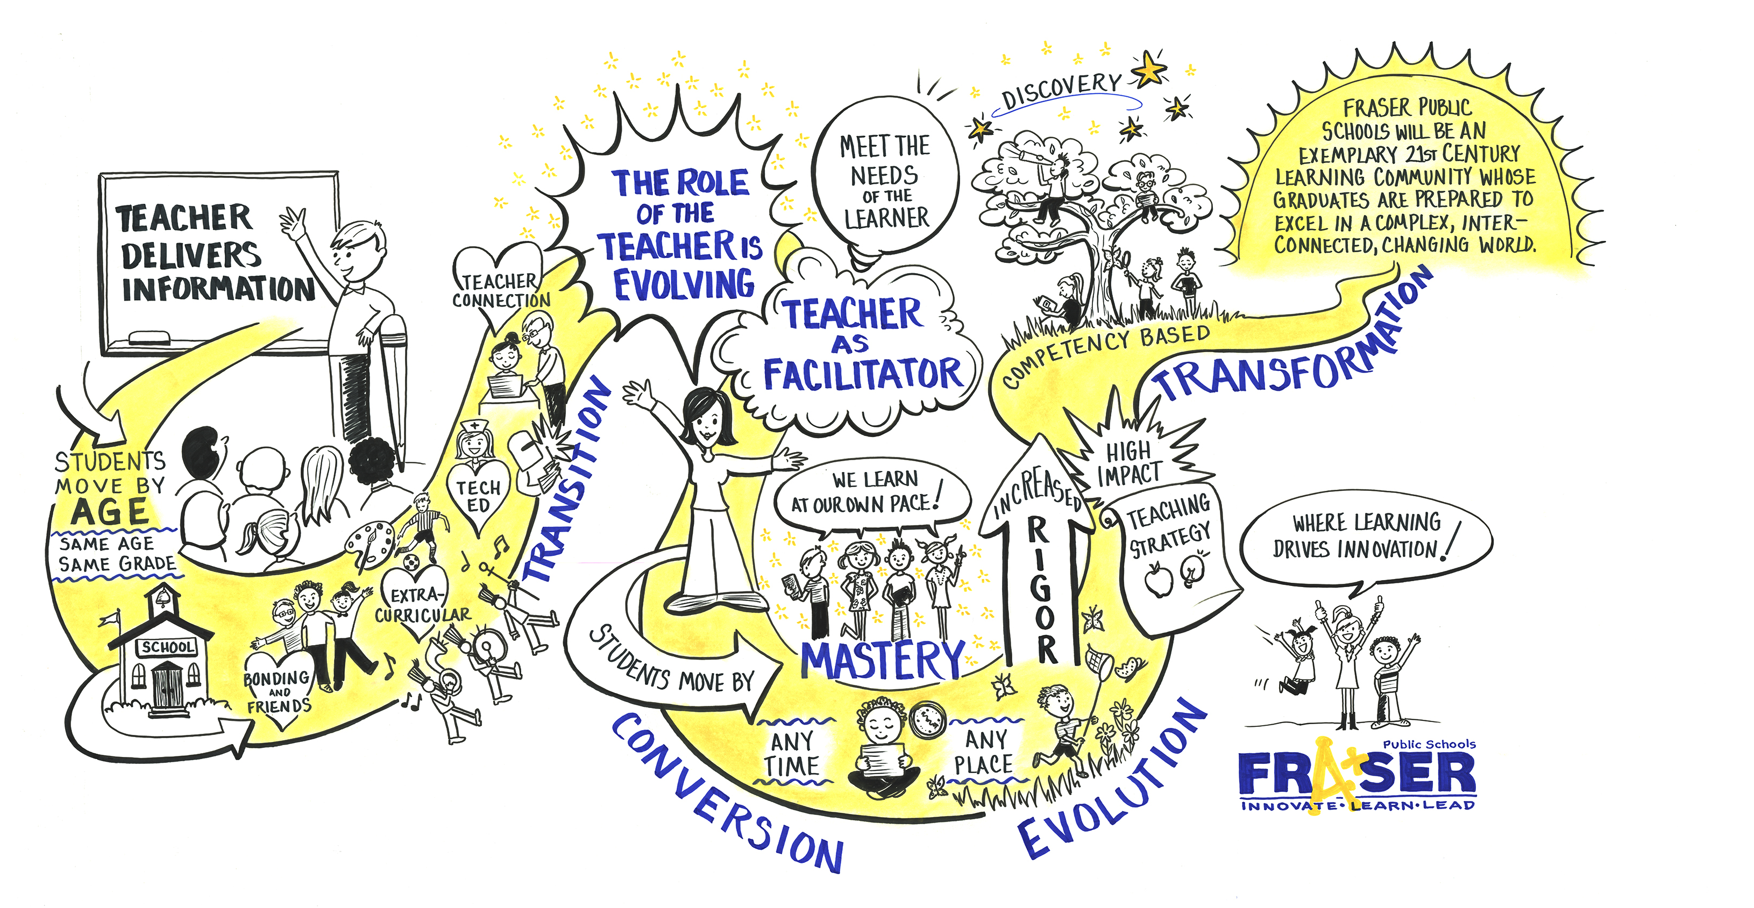

Slide 6
Competency Based Learning
Refers to systems of instruction, assessment, grading, and academic reporting that are based on students demonstrating that they have learned the knowledge and skills they are expected to learn as they progress through their education.
Notes:
Carrie

Slide 7
Competency Based Learning
In public schools, competency-based systems use state and national learning standards to determine academic expectations and define “competency” and “proficiency” in a given course, subject area, or grade.
Competency with proficiency…
Notes:
Carrie

Slide 8
MARZANO’S HIERARCHICAL STRUCTURE FOR HIGH RELIABILITY SCHOOLS
Marzano: Becoming a High Reliability School, The Next Step in School Reform.
Marzano’s organizational concept demonstrates the idea that when “the public expects fail-safe performance, successful organizations adjust their operations to prevent failures” (Thomas Bellamy).
Notes:
Carrie

Slide 9
High Reliability Schools
Marzano proposes that the factors identified in the research to date are best organized into five levels that represent a hierarchy when one takes a high reliability perspective.
A school cannot operate fully as a High Reliability Organization at one level if it is not already operating as an High Reliability Organization at the previous level.
Notes:
Carrie

Slide 10
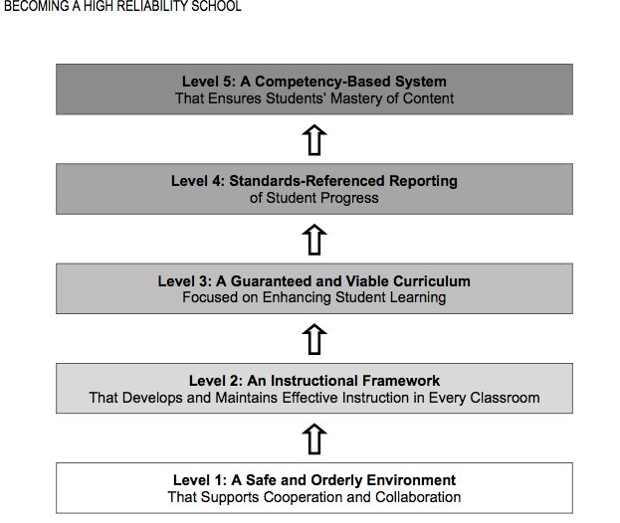
Notes:
Mike

Slide 11

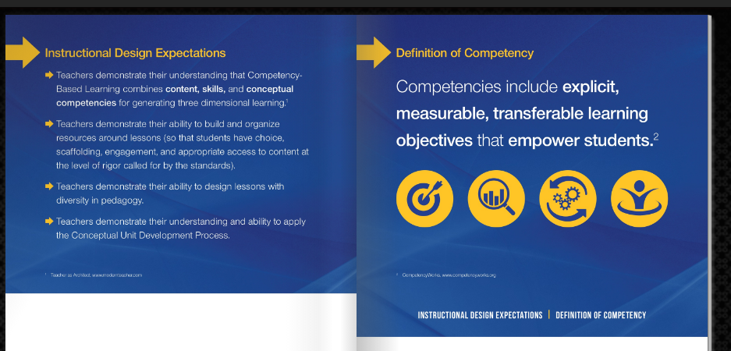
Fraser’s Model
http://cblflipbook.fraser.k12.mi.us
Notes:
Carrie

Slide 12

DEVELOPING THE FRASER FRAMEWORK FOR COMPETENCY BASED LEARNING
In order to customize the learning experience and implement a competency based learning model, we needed to have defined competencies that are vertically aligned by both grade level and between courses.
By the end of the 2014 – 2015 school year, we developed a DK – 12th Grade vertically articulated road map of critical competencies we expect of a Fraser Graduate. This work is being completed through the PLC process.
Notes:
Carrie

Slide 13

What does it take to get the handshake at graduation?
Notes:
Carrie

Slide 14
FRASER’S CBL FRAMEWORK
For each discipline (Math, Science, ELA, Social Studies, Foreign Language, and Electives), we identify the standards, skills, content, macro and micro concepts, and enduring understandings by grade band (district) and unit (grade).
K-2
3-5
6-8
9-12
Notes:
Mike

Slide 15
FRASER’S CBL FRAMEWORK, CONT.
Identify competency statements to describe 3-Dimensional Learning Competencies (one for each knowledge dimension)
Declarative Knowledge – Content Competency
Procedural Knowledge – Skill Competency Process, Skill, and Habits of Mind
Conceptual Knowledge – Concept Competency Relationships within and across disciplines (organized around unifying ideas that support deep learning of content)
Resource: Modern Teacher Flip Book
Notes:
Mike

Slide 16
FRASER’S CBL FRAMEWORK, CONT.
District Level – Overarching Goals
(What do we want a Fraser Graduate to know and be able to do?)
Course/Grade Level (Units of Instruction)
Content Competency
Skills Competency
Conceptual Competency
(Students will …)
Lesson Level - Learning Objectives
(I can statements…) that are aligned to Standards and linked back up the to Competencies.
Notes:
Mike

Slide 17
FHS Competency Development - Sources
Notes:
Mike

Slide 18
The implementation of Competency Based Learning has led to changes in both the Learning Environment and use of Time.
Focus on Student Learning
Media Center Redesign
Blended/Hybrid Classes
Seminar Redesign (Led to the presentation to the Michigan Department of Education - Innovation Council)
Notes:
Mike

Slide 19
EXPLORE OUR CBL JOURNEY
Notes:
Carrie

Slide 20

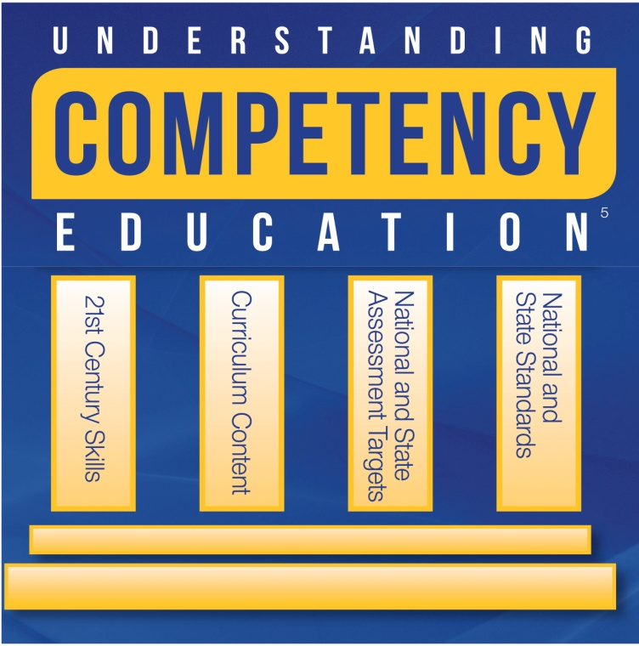



FRASER HIGH SCHOOL
Competency Based Learning
Hybrid Courses
Standards
Based Learning
Flexible Scheduling
2010
Winter 2012
2014-2016
Phase 2
Phase 3
Teacher Driven Conversation around
Transforming the Learning Environment
FOCUS:
Curriculum, Assessment,
and Lesson Design
Move on When Ready
Summer 2015
Content area curriculum leaders began to write and design competency statements in the core areas using National and State Standards
Notes:
ML

Slide 21
Assessment and Grading
Assessment Analysis Tool
Blackboard and Grade book Setup
Glossary of Terms

Slide 22
Digging Deeper Resources
http://frasercbl.weebly.com/
Questions

