Slide 1
Fraser Public Schools
November 8th, 2018
District Site Visit

Slide 2


Welcome and Agenda!

Slide 3
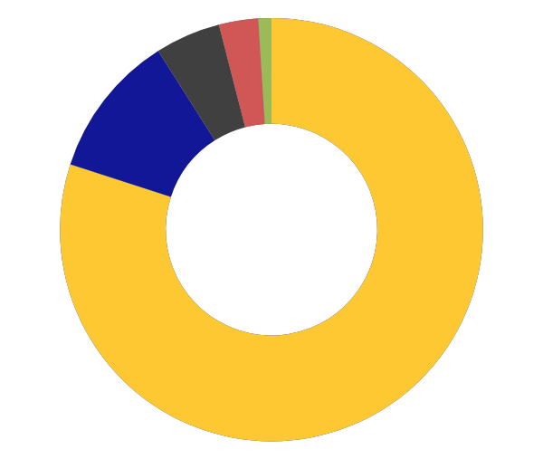

FRASER TODAY
[9] SCHOOLS IN THE DISTRICT
[4,971] STUDENTS
[1,967] SCHOOL OF CHOICE STUDENTS (39% OF POPULATION)
[39%] STUDENTS RECEIVING FREE/ REDUCED LUNCH
CAUCASIAN (76%) ♦
AFRICAN AMERICAN (13%) ♦
MULTI-RACIAL (6%) ♦
HISPANIC (3%) ♦
ASIAN (2%) ♦
Notes:
Dave

Slide 4
How did we get to this place?
Developing a Modern Curriculum
  NGSS, C3, Common Core
Shifting from a focus on Standards to Competency Based Education
Developing a Digital Ecosystem (LMS)
Developing Instructional Models in a Blended Environment to Increase Rigor and Engagement
Notes:
Activity

Slide 5
Fraser Today

Slide 6

Fraser Focus for 2018-2019
Viewing the district work with a new lens.
Priorities:
  establishing a strong school and community presence right from the start
  implementing collaborative plans that build on the exceptional work that has already occurred throughout the district.
  a clear focus on student learning and engagement.

Slide 7
Key Action Items - 2018
Implementation of a strategic Learning Model (Universal Design for Learning and Design Thinking) to increase student learning and engagement.
Portrait of the Graduate - Supporting the next phase of Strategic Planning
School Safety
  Physical
  Mental

Slide 8
Key Action Items - 2018
Work with all Fraser stakeholders to evaluate the performance of district schools and assess performance indicators of current initiatives – specifically focusing on Competency Based Education:
  Evaluate Fraser’s digital ecosystems (Learning Management Systems and Student Information System)
  Evaluate Fraser’s Competency Based Practices (Key Factors: student ownership of learning – increasing engagement and motivation, the continuum of learning K-12, and opportunities for educator reflections/evaluations of process)

Slide 9
Key Action Items - 2018
Focus on Strategic District Professional Development
Implementation of the 2018 Competency-Based Education Pilot Grant
Continued implementation of the work with the Michigan Department of Education - Innovation Council (i.e. Seat Time Waiver)
Implementation of a strategic Learning Model (Universal Design for Learning and Design Thinking) to increase student learning and engagement.
Portrait of the Graduate - Supporting the next phase of Strategic Planning

Slide 10

Key Action Items - 2018
Review and monitor the implementation of the district family engagement plan –specifically focusing on the 3rd Grade Reading Law and parent involvement (Ensure plan includes training and development for parents to understand student performance data and information to support parents as informed advocates for their children.)
Review student data for all student populations and leverage Fraser’s current Multi-Tiered Systems of Supports to provide data for improving academic achievement

Slide 11
Key Action Items - 2018
Review and monitor Fraser’s instructional technology plan for the fall of 2018
Evaluate Fraser’s learning environments within the classroom, hybrid, and online learning spaces (Key Factors: 2018 Bond Monies focusing on technology and classroom redesign)
Evaluate the impact of technology on time, place, and pace of learning
  Review and begin to develop a process for Fraser Public School’s next strategic plan

Slide 12
Key Action Items - 2018
Evaluate and assess district supports for student services in the area of mental health and counseling support
Continue to establish a district process (with resources and training) to improve the evaluation of student threat assessments

Slide 13

Turn and Talk
Identify one word the resonates with you.
What was the key Fraser Focus take-away you had?
How does that connect to your role within your district?

Slide 14

Portrait of a Graduate

Slide 15
Every school system is unique,
but they are connected by a shared aspiration: that all students have an educational experience preparing them to be effective lifelong learners and contributors.

Slide 16
Strategic Planning
Many school systems across the country have engaged their larger community in developing a Portrait of a Graduate, a collective vision that articulates the community’s aspirations for all students.

Slide 17
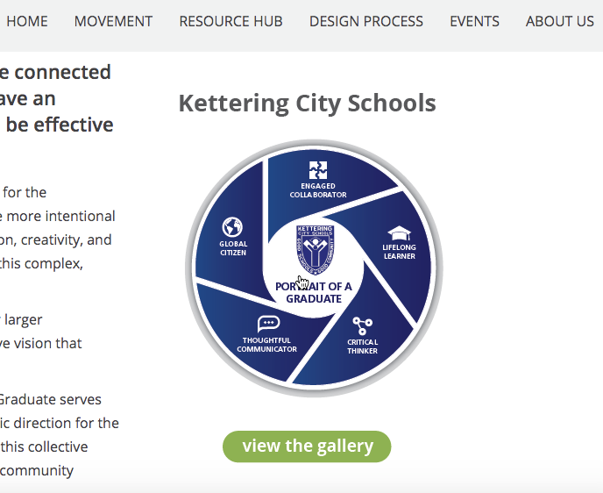
Portrait of the Graduate
Sample Portrait of Graduate.
https://portraitofagraduate.org/
https://fraserportrait.weebly.com/

Slide 18

UDL and Classroom Learning Spaces - Macomb ISD
https://docs.google.com/presentation/d/1pD_sRN5FA-mIvC57FYEWQ2RhMvRIPjLGA06xm6DWifQ/edit?usp=sharing

Slide 19
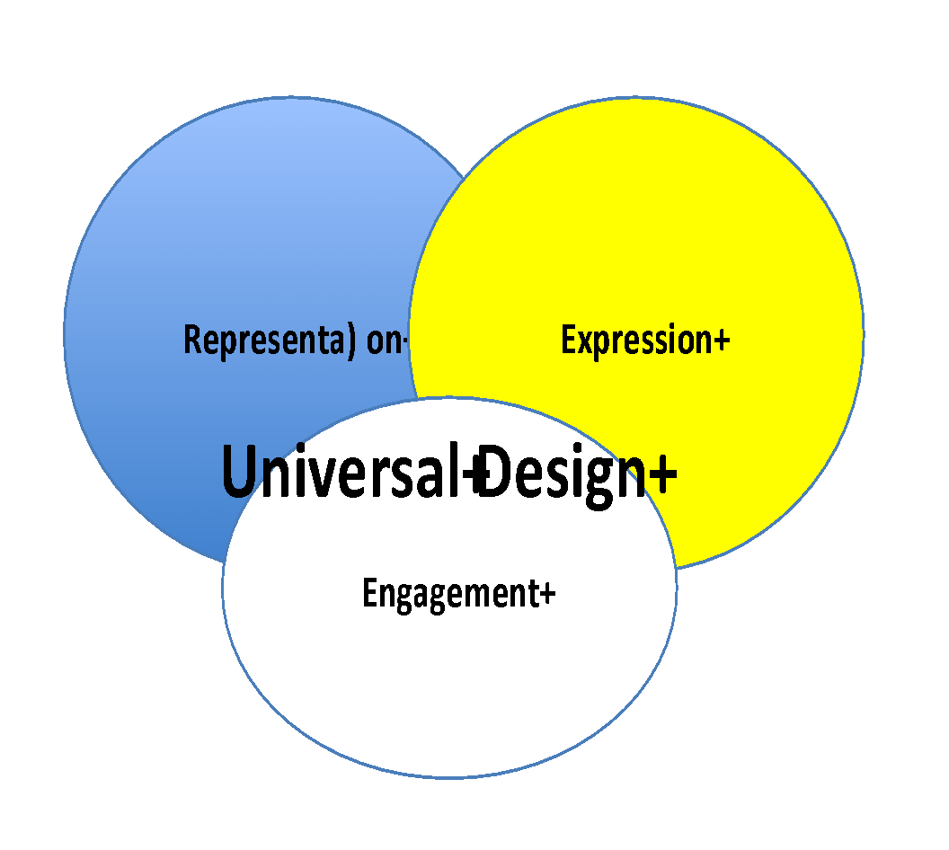

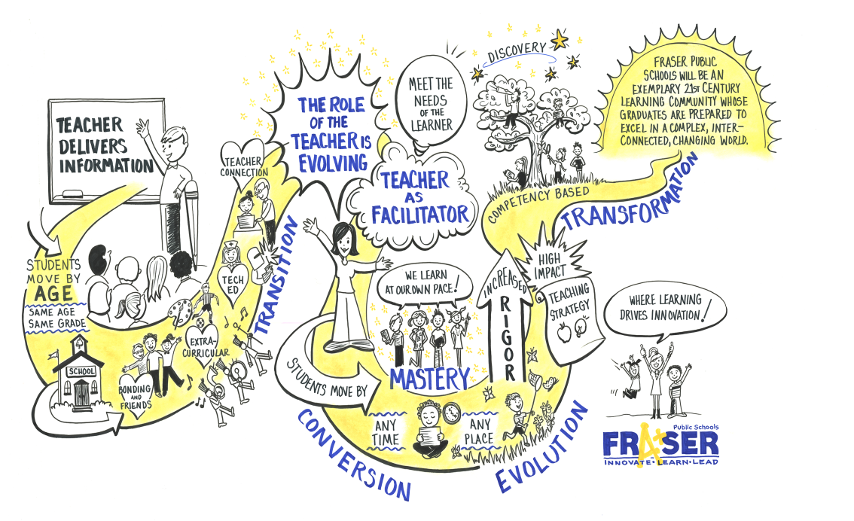
FRASER CBL CONVERSION
Fall 2013
Standards Based Learning at FHS
Strategic Planning Process Begins
Modern Teacher Training Begins
Fall 2012
Universal Design for Learning
Representation
Engagement
Expression
2012 - 2013
2013 - 2014
2014 - 2015
Summer 2015
Spring 2013
Ad Council discussion on
CBL and FPS Mission
Spring 2014
LMS Review and Selection
CBL Training with Staff
Strategic Plan Finalized
Driver: Instructional Model
Notes:
Dave

Slide 20


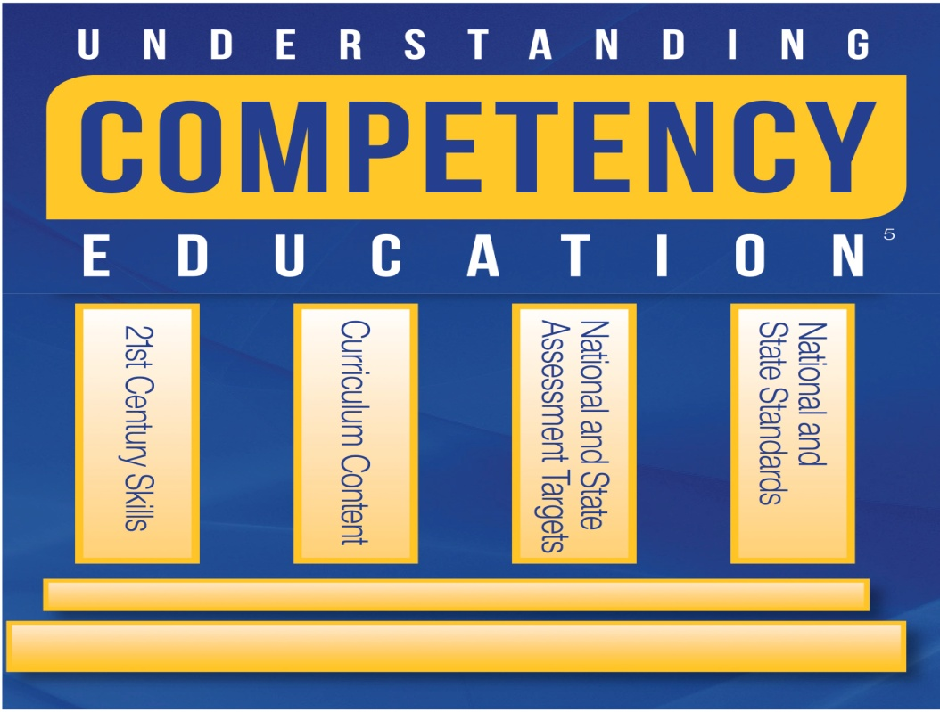
FRASER CBL CONVERSION
Fall 2013
Standards Based Learning at FHS
Strategic Planning Process Begins
Modern Teacher Training Begins
Summer 2015
Content area curriculum leaders began to write and design competency statements in the core areas using National and State Standards
Fall 2012
Universal Design for Learning
Representation
Engagement
Expression
Fall 2014
Launch of itslearning LMS
CBL Content Development
2012 - 2013
2013 - 2014
2014 - 2015
Summer 2015
Spring 2013
Ad Council discussion on
CBL and FPS Mission
Spring 2014
LMS Review and Selection
CBL Training with Staff
Strategic Plan Finalized
Spring 2015
District level focus on building a common language around Competency Based Learning
Driver: Digital Ecosystem
and Modern Curriculum
Notes:
Dave

Slide 21
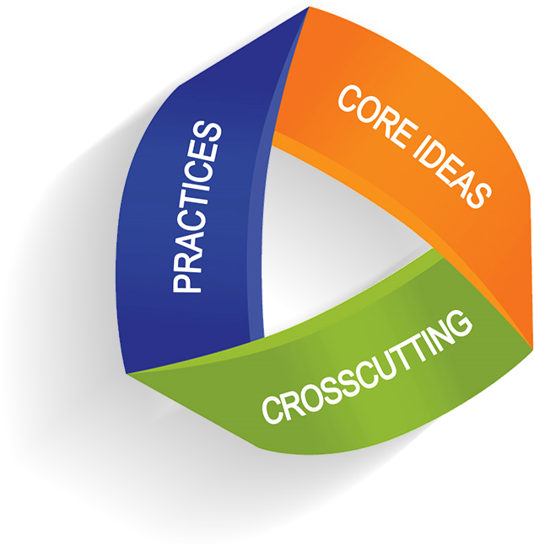


FRASER CBL CONVERSION
Fall 2015
District Led CBL Curriculum and Unit Design Work to create a K-12 framework for teaching and learning
Fall 2015
Winter 2016
Summer 2016
Fall 2016
Winter 2017 to Today
Winter 2016
Consensus Building Around Competency Design
Driver: Modern Curriculum
Notes:
Dave

Slide 22
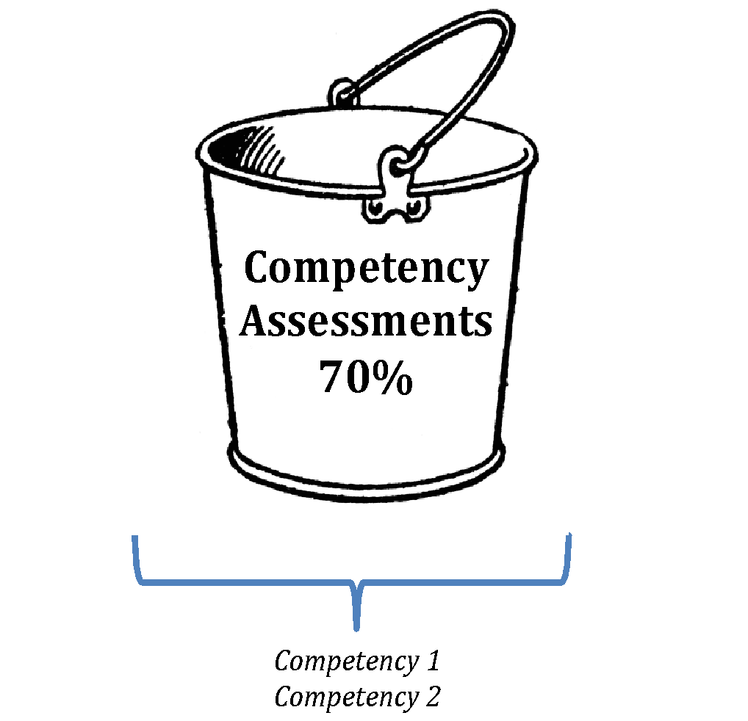

FRASER CBL CONVERSION
Fall 2015
District Led CBL Curriculum and Unit Design Work to create a K-12 framework for teaching and learning
Summer 2016
Instructional Design Protocols for the Learning Management System
Fall 2016
A Systemic Approach to Assessment and Competency Based Learning Grading
Fall 2015
Winter 2016
Summer 2016
Fall 2016
Winter 2017 to Today
Winter 2016
Consensus Building Around Competency Design
Driver: Digital Ecosystem
Notes:
Dave

Slide 23
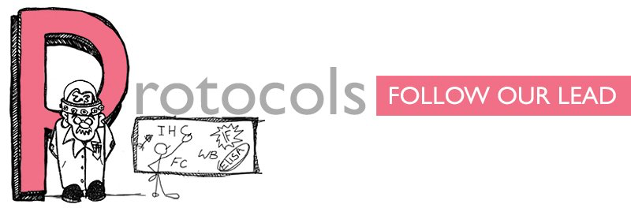
FRASER CBL CONVERSION
Fall 2015
District Led CBL Curriculum and Unit Design Work to create a K-12 framework for teaching and learning
Summer 2016
Instructional Design Protocols for the Learning Management System
Fall 2016
A Systemic Approach to Assessment and Competency Based Learning Grading
Fall 2015
Winter 2016
Summer 2016
Fall 2016
Winter 2017 to Today
Winter 2016
Consensus Building Around Competency Design
Winter 2017
Creating Instructional Protocols for Classroom Implementation of CBL
Driver: Instructional Model
Notes:
Dave

Slide 24
Competency Based Learning
Refers to systems of instruction, assessment, grading, and academic reporting that are based on students demonstrating that they have learned the knowledge and skills they are expected to learn as they progress through their education.
Instructional Models

Slide 25
Competency Based Learning
In public schools, competency-based systems use state and national learning standards to determine academic expectations and define “competency” and “proficiency” in a given course, subject area, or grade.
Competency with proficiency…
Instructional Models

Slide 26
FRASER’S CBL FRAMEWORK
For each discipline (Math, Science, ELA, Social Studies, Foreign Language, and Electives), we identify the standards, skills, content, macro and micro concepts, and enduring understandings by grade band (district) and unit (grade).
K-2
3-5
6-8
9-12
Instructional Models
Notes:
Mike

Slide 27
FRASER’S CBL FRAMEWORK, CONT.
District Level – Overarching Goals
(What do we want a Fraser Graduate to know and be able to do?)
Course/Grade Level (Units of Instruction)
Content Competency
Skills Competency
Conceptual Competency
(Students will …)
Lesson Level - Learning Objectives
(I can statements…) that are aligned to Standards and linked back up the to Competencies.
Instructional Models
Notes:
Mike

Slide 28
FRASER’S CBL FRAMEWORK, CONT.
Identify competency statements to describe 3-Dimensional Learning Competencies (one for each knowledge dimension)
Declarative Knowledge – Content Competency
Procedural Knowledge – Skill Competency Process, Skill, and Habits of Mind
Conceptual Knowledge – Concept Competency Relationships within and across disciplines (organized around unifying ideas that support deep learning of content)
Resource: Modern Teacher Flip Book
Instructional Models
Notes:
Mike

Slide 29

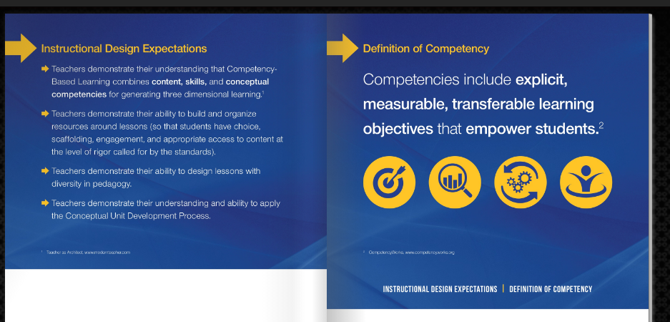
Fraser’s Instructional Model
http://cblflipbook.fraser.k12.mi.us
Instructional Models
Notes:
Carrie

Slide 30
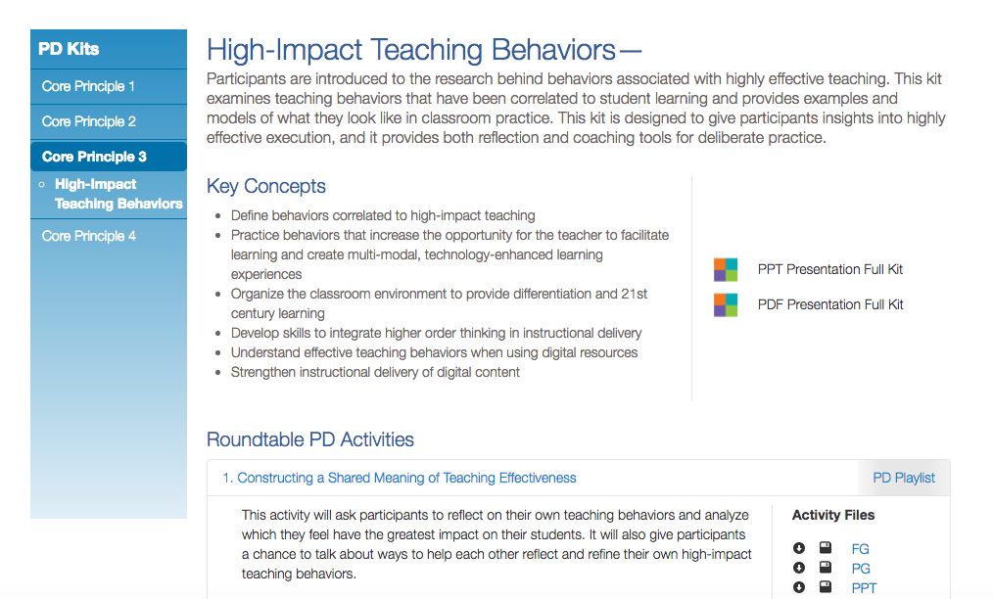
Common Language – Teacher as Architect
Professional Learning

Slide 31
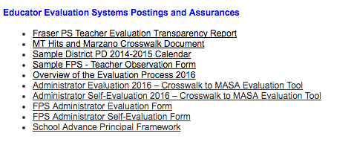
Connected to Teacher Evaluation - TAA
http://www.fraser.k12.mi.us/pages/FraserPS/Budget_and_Salary_Compensation
Professional Learning

Slide 32

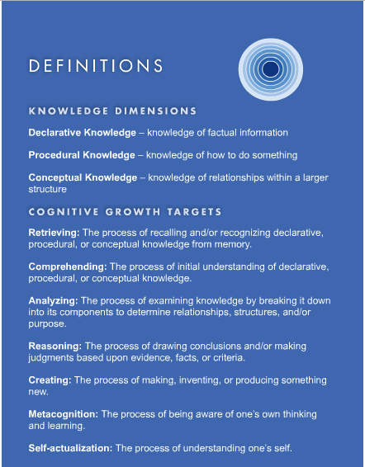
TAA Connected to our Competency Based Learning Work
Instructional Models

Slide 33

What does it take to get the handshake at graduation?
Notes:
Carrie

Slide 34
Digging Deeper Resources
http://frasercbl.weebly.com/
Questions

Slide 35
Overview of Richard Middle School
Multi-Tiered Systems of Support
  District Focus
  Middle School Focus
Learning Environment – Universal Design for Learning

