Slide 1
Student Involved Conferences
Grades K-6

Slide 2
Student Involved Conferences

Slide 3
What is Student Agency?
Student agency refers to the level of control, autonomy, and power that a student experiences in an educational situation. Student agency can be manifested in the choice of learning environment, subject matter, approach, and/or pace.
Student agency can become a schoolwide norm through Student Led Conferences.

Slide 5
How Do Student-Involved Conferences Work?
Though the format may vary, these conferences differ from traditional conferences in that they place students at the helm of teacher-supported discussions with parents about student progress and learning. They also often present opportunities for students to prepare, reflect on, and discuss evidence of their learning and growth.
Schools that implement student-led conferences report that they:
Encourage students to take responsibility and ownership for their learning by involving them in the goal-setting and assessment process.
Engage families in richer, more transparent conversations about student progress.

Slide 6
How do Student Involved Conferences Fit?
Goals in ITS
Growth Mindset Work
Competency Work
Student Centric Work

Slide 7
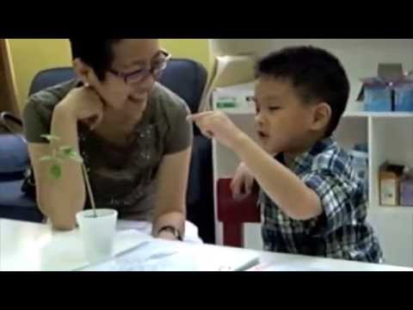
Notes:
Just the beginning...

Slide 8
Benefits of Student-Led Conferences
Students take ownership of their learning.
Parents and students have open communication about school, after-school activities and other important decisions in life.
Teachers establish a stronger working relationship with parents and students.

Slide 9
Before the Conference:
Students:
Create learning goals.
Collect work samples
Review their work with the teacher and learning partners.
Teachers:
Assist students In setting measurable goals
Assist students with pinpointing their strengths and weaknesses.
Guide students in the collection of work samples
Review learning goals.
Explain the conference as a learning process to parents.
Set up a conferring schedule.

Slide 10
During the Conference:
Students:
Share and discuss learning goals
Identify strengths and learning goals
Determine next steps to improve learning.
Teachers:
Act as a guide and offer positive feedback.
Identify new learning goals with students and parents.
Inquire about students’ long-term goals.
Assist students and parents in determining the next steps for learning.

Slide 11
Loose/Tight

Slide 12
Student Led Conferences

Slide 13
Second Grade Example

Slide 14
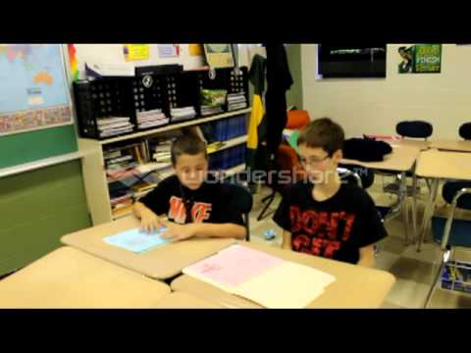
Sixth Grade Example

Slide 15
Notes:
Additional

Slide 16
Grade Level Team Plan
What questions do you have?
What materials do you need?
What support do you need??

Slide 17
Resources
http://www.educationworld.com/a_admin/admin/admin112.shtml
http://www.edutopia.org/blog/student-led-conferences-resources-ashley-cronin
http://www.competencyworks.org/resources/supporting-student-agency-through-student-led-conferences/

